Slide 2
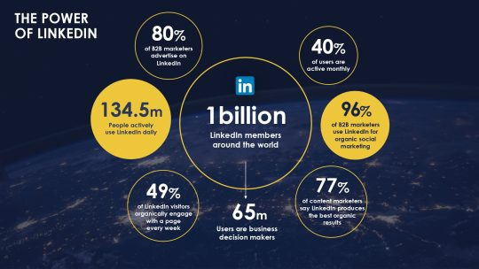
Why LinkedIn Matters
LinkedIn is the world’s largest professional network.
It’s not just for job seekers—it’s for personal branding, networking, and building trust.
90%+ of recruiters actively use LinkedIn to hire.
Great place to showcase your projects, get freelance work, and learn from experts.

Slide 3
How to Build a Strong LinkedIn Profile (Step by Step)
1. Profile Photo
Use a clear, friendly, professional headshot.
Avoid selfies, filters, or distracting backgrounds.
2. Headline
Go beyond just “Student” or “Developer”.
Example: "MERN Stack Developer | Front-End Enthusiast | Building Web Experiences"

Slide 4
3. About Section (Summary)
A brief intro (3–4 lines) about:
Who you are
What you do
What you’re passionate about
What kind of work you’re looking for
Use first person ("I am passionate about building...")
4. Experience / Projects
List any:
Freelance work
Internship or job
Personal/academic projects (with GitHub or live links)
Use bullet points to explain what you did.

Slide 5
5. Skills
Add relevant skills: HTML, CSS, React, Node.js, MongoDB, Git, REST API, etc.
Endorsements help build credibility.
6. Education
Mention degree, certifications, bootcamps or online courses.
7. Featured Section
Showcase your top projects, portfolios, blogs, or videos.
Link to GitHub, CodePen, or portfolio website.

Slide 6
LinkedIn Best Practices for Web Developers
Post your project updates and code challenges
Write short posts on what you're learning (e.g. “Today I learned how to use React useEffect”)
Follow and engage with influencers and tech communities
Comment with value, not just emojis
Avoid spammy DMs — build authentic relationships
Join groups for Web Developers / Freelancers
Optimize profile for keywords like “Web Developer”, “JavaScript”, “React.js”

Slide 7
How LinkedIn Can Help You as a Developer
Job Opportunities: Companies hire directly from LinkedIn
Freelancing: Clients often check your profile before hiring
Visibility: Recruiters can find you via keyword search
Networking: Connect with other developers, clients, mentors
Learning: Follow tech blogs, companies, and developers sharing daily insights
LinkedIn Optimization Checklist
Professional photo
Compelling headline
Clear, honest summary
Updated project/work history
Skills list with endorsements
Certifications added
Active and engaging profile

Slide 8
Home Tasks for Students
Create a LinkedIn account (if you don’t have one).
Add a professional photo and headline.
Write your “About” section in your own words.
Add your portfolio project or GitHub link in the “Featured” section.
Connect with 10 developers or classmates.
Follow 5 influencers (e.g., Fireship, Brad Traversy, Angela Yu, etc.)
Make your first post — e.g., "Started learning MERN stack today!"
Comment something valuable on someone else’s post.

Slide 9
Git, GitHub

Slide 10
What is Git?
Git is a Version Control System (VCS) that helps you track changes in your code.
Created by Linus Torvalds (also created Linux).
You can:
Track revisions
Revert to previous versions
Collaborate with others without overwriting code
Commands:
git init – Initialize repo
git status – Check current status
git add – Stage files
git commit -m "msg" – Save changes
git log – View commit history

Slide 11
What is GitHub?
GitHub is a cloud-based platform to store and manage Git repositories/folder.
Think of it like Google Drive for your code, but more powerful.
You can:
Host and share code
Collaborate with others
Use issues and pull requests
Showcase your work to the public

Slide 12
Git vs GitHub
Feature | Git | GitHub
What is it? | Version Control Tool | Hosting platform for Git repos
Works Offline | Yes | No
Local or Cloud | Local | Cloud (also GitHub Desktop)
Key Use | Track changes | Share & collaborate

Slide 13
How to Use Git and GitHub Together
Create a GitHub account
Create a repo on GitHub
Clone it to your computer: git clone
Make changes locally, use Git commands:
git add .
git commit -m "initial commit"
git push origin main
Changes go live to your GitHub repo

Slide 14
Why Git & GitHub Are Essential for Web Developers
Version history of your projects
Backup of your code in the cloud
Collaborate on open-source or team projects
Display your code to clients and recruiters
Use GitHub Pages to host portfolios for free
Integrate with CI/CD, Netlify, Vercel, etc.

Slide 15
Build a Strong GitHub Profile
Tips for Students:
Add a professional profile picture and bio
Pin your best 3–6 repositories (e.g., Portfolio, Blog, API app)
Use meaningful README files in each project
Contribute to open-source or your own mini-projects
Organize repos using folders and labels
Update your contributions graph by staying active

Slide 16
Connecting GitHub to LinkedIn
Add your GitHub link to:
LinkedIn Featured section
LinkedIn About section
LinkedIn Projects or Experience
Post regularly on LinkedIn:
“I built this app using React & Node. Here's my GitHub link 👇”
Use hashtags like #github, #webdevelopment, #100DaysOfCode
Make your GitHub profile link short with a custom domain: e.g., git.munim.dev

Slide 17
Home Tasks for Students
Install Git on your PC (Windows/Mac/Linux).
Create a GitHub account.
Add GitHub link to your LinkedIn.

Slide 18
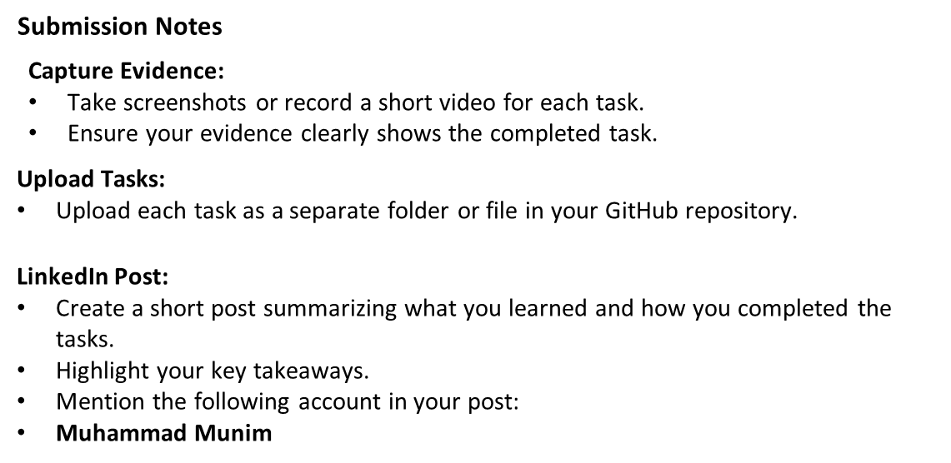

Slide 19


